Slide 2
Ella Marie O’Doherty
Michael Diamond
Mikolaj Piotrowski
Rory Byrne
Séan Byrne

Slide 3
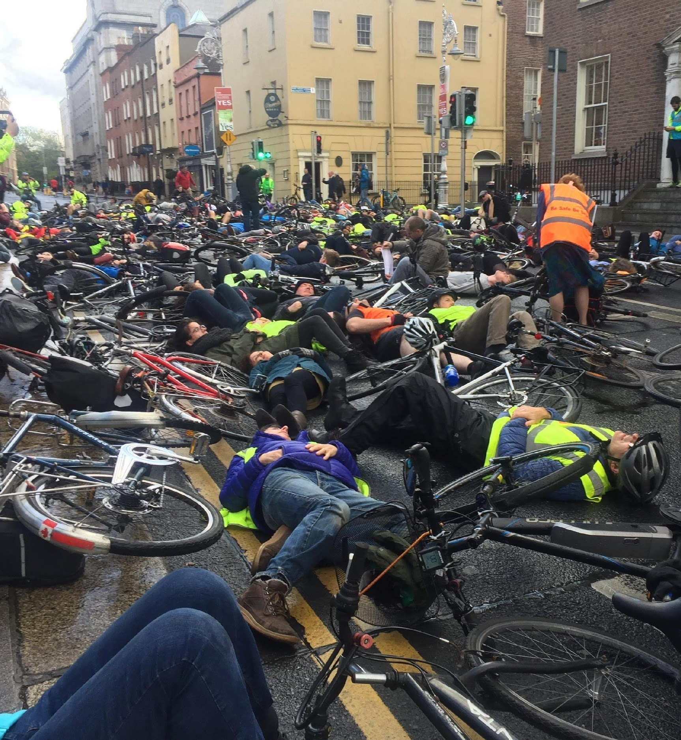
Problem
Safety for cyclists is a huge issue particularly due to lack of segregated cycle lanes available in Ireland.
Cars and Bikes share the road, however cyclists are not respected and treated with due care
Blind Spots are cause for concern in a lot of situations but we believe it is especially problematic for cyclists as the most vulnerable road user.
48% of interviewed cyclists said they felt unsafe when cycling in the city

Slide 4
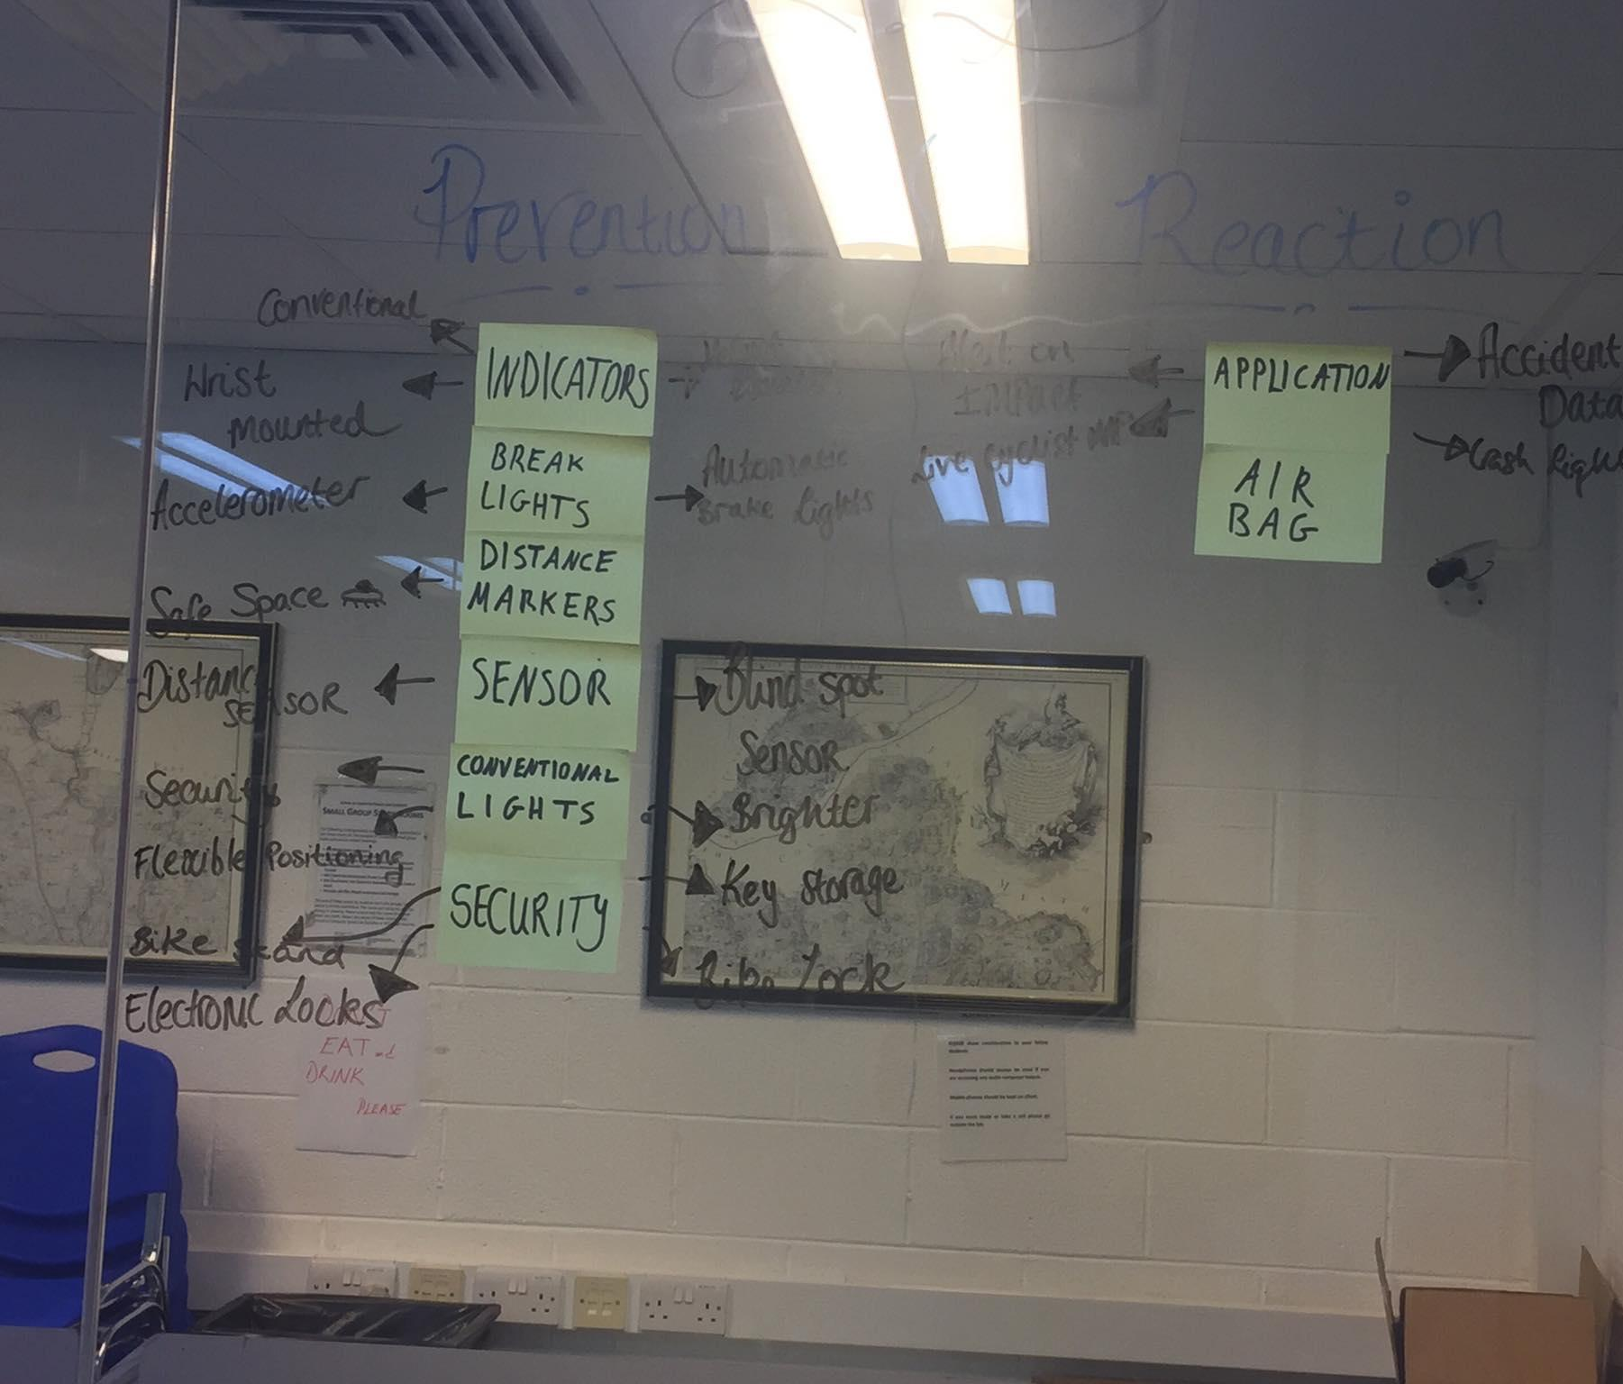
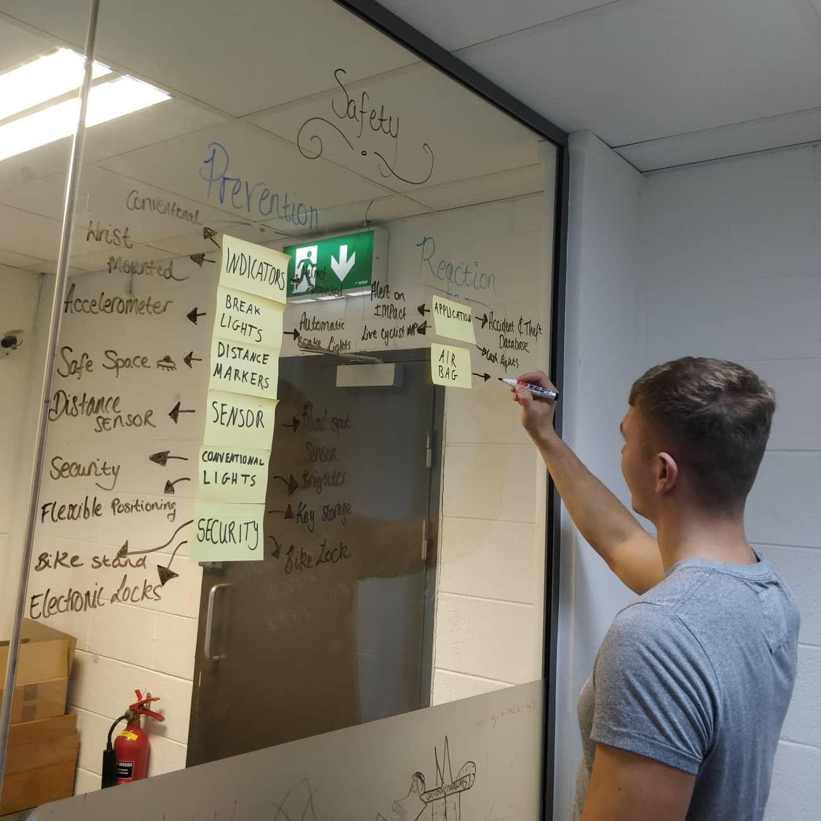
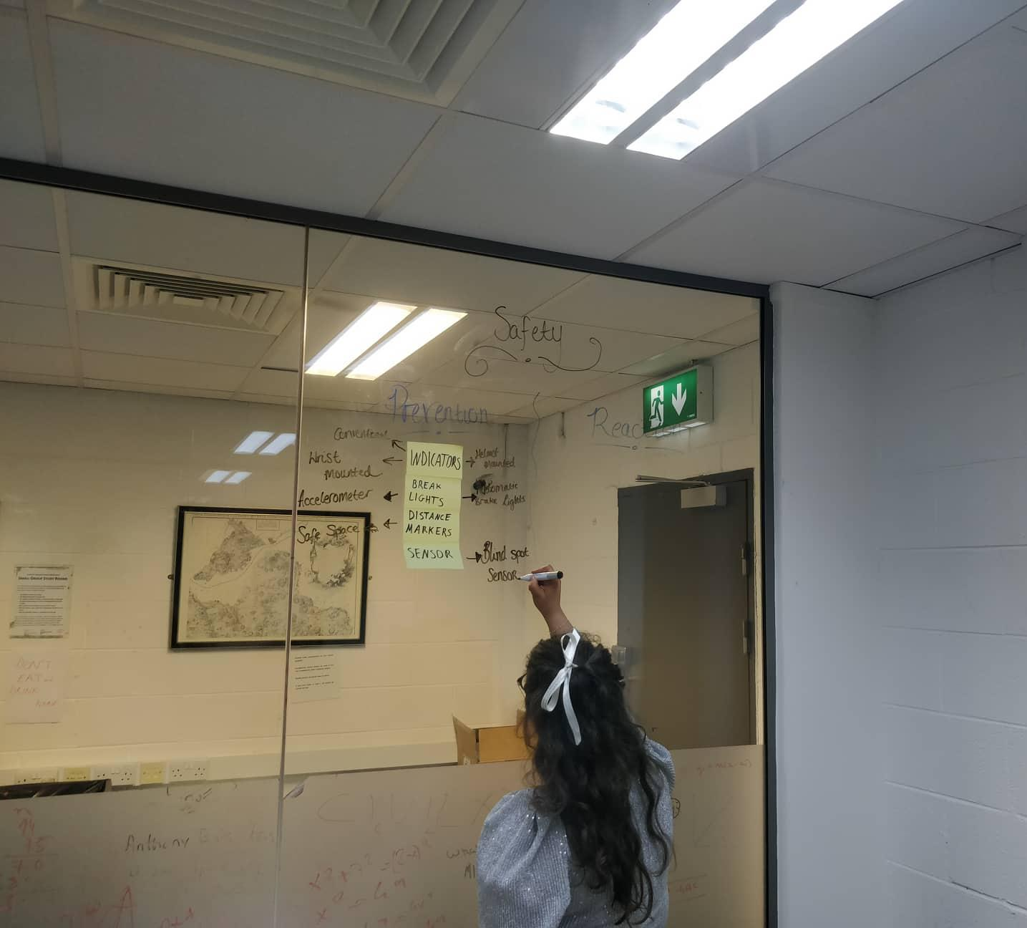
Needfinding & Stakeholder Feedback
We found that after conducting our needfinding research we uncovered a number of issues our stakeholders were faced with when it comes to transportation specifically issues cyclists were having with safety, accessibility and prevention.
After having a group meeting and brainstorming sessions we decided on our missions statement and possible solution strategies.

Slide 5
Feedback
“Cyclists always have to assume cars are going to do something silly, an active system to help them take care of themselves would be ideal”
- Bike shop worker
The Bike Stand, Johnstown
“Hand bikes tend to have a very low centre of gravity and can make it quite hard to turn around to see what’s behind you. It’s also much more common for cars not to notice you”
- IWA Representative
“It would be useful to be able to know when potholes are coming. I’ve burst a tire a few times from not seeing them when in a rush”
- Deliveroo Driver
“I listen to music cycling and I always get a fright from passing by cars. It would be great to get some kind of a heads up before the car approaches.”
- Commuter Cyclist

Slide 6
Mission statement
To alert cyclists of potentially unseen threats using multisensory feedback.
To alert cyclists of potentially unseen threats using non-visual sensory feedback
To alert cyclists of potentially unseen threats using non-visual sensory feedback

Slide 7
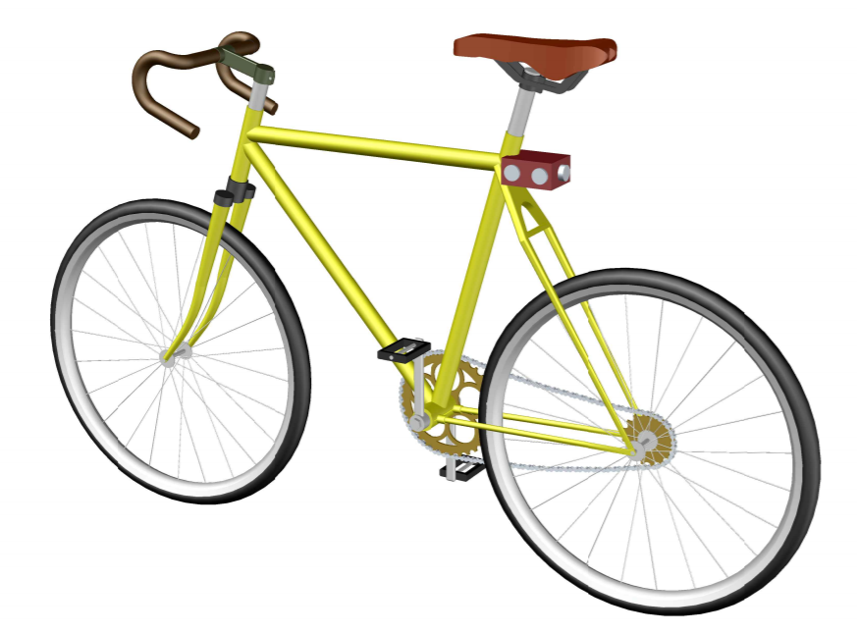
Selected concept:
Proximity and Alert System
DISPLAY FOR VISUALISING DISTANCE TO VEHICLE
PROXIMITY
SENSOR
(PARALLEL &
PERPENDICULAR)
HANDLEBARS
VIBRATE ON DETECTION

Slide 8
How does it work?
4,5,6
3
2
1.The TF mini LiDAR detects an approaching car and calculates the distance away from the module to the car.
2. Distance is split up into intervals of distances, each interval is represented by a character.
3.The character corresponding to the distance interval is sent to the front of the bike via Bluetooth.
4.This character is received at the front of the bike via Bluetooth, this character is then passed into the Arduino Nano board of the receiver.
5.Once the character is received an action is taken by the hardware connected to the Arduino Nano board.
6.Presuming the car has approached a distance of less than 3 meters of the bike the handlebars of the bike will vibrate and the LED strip will illuminate to correspond to the distance.
1

Slide 9
Components
Bike sense uses 3 major components: TF mini LiDAR, Arduino Nano (x2) & HC-05 Bluetooth module (x2)
Component | Function
Arduino Nano | Process information and control components connected via stored code
TF mini LiDAR | Calculate the distance between the module and an object up to 10 meters
HC-05 Bluetooth | Send or receive information wirelessly

